Slide 1

Accelerating Outcomes through a regional approach
Adrian Carson,
Institute for Urban Indigenous Health

Slide 2

Largest Indigenous population in Australia
South East Queensland
Second fastest growing region in Australia
A 6.7 year life expectancy gap to close in 7 years
Notes:
Southeast Queensland has the largest Indigenous population in Australia.
ABS projections based on the 2021 Census data has the current population in Southeast Queensland at around 124,000, and it's expected to grow to around 150,000 by 2031.
We are also the 2nd fastest growing region – behind Perth and ahead of the Townsville-Mackay region.
However, while the Indigenous population in Southeast Queensland is large compared to other regions, it is just small proportion of our total population in South East Queensland – around 2.8%
And while there may be more health services in Southeast Queensland navigating services across multiple hospitals and multiple service providers is hard.
If we are to close the 6.7 year life expectancy gap in South East Queensland in the next 7 years, we to accelerate efforts and work at a system level, across our region, to deliver local solutions.
This means that all parts of the health system need to work together better – and in South East Queensland that means we have to work across organisational boundaries and catchments.

Slide 3
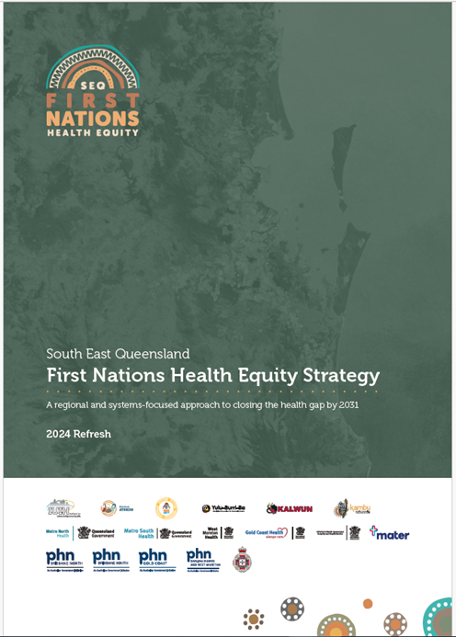
Accelerating efforts through a regional approach
First Nations-led
Harnessing the strengths of each partner.
Working across the continuum of care.
A regional approach supporting local implementation.
Notes:
When the Queensland Health Equity legislation was introduced, not long after the new Closing the Gap Agreement was signed in 2020, and not long after Queensland Health released the ‘McGowan’ report, which talked about the importance of networked systems, it became clear that our best approach for accelerating efforts to Close that Gap in South East Queensland would be through a regional approach.
Hospital and Health Services would continue to develop their local Health Equity Strategies with their local ACCHOS and Primary Health Networks, but we would come together as a regional partnership to take a regional and system approach to accelerating efforts.
We know that First Nations led-partnerships and services will deliver better outcomes for First Nations patients and return a benefit to our hospital system.
The SEQ First Nations Health Equity partnership is First Nations led and places First Nations families and communities at the centre of all we do.
Through this partnership we are working together to to unleash the potential within the system – locally and regionally.

Slide 4
Partnering for regional investment - Connected Community Pathways
Dental services
Took a regional approach.
Identified shared priorities.
Each HHS submitted 1 x SEQ First Nations proposal.
Funding flows to ACCHOs to deliver and/or coordinate care.
More than $11M into the region.
Early intervention for vulnerable youth
Heart Outreach
Pain Management
Public Health Integration
Women’s Cancer pathways
Notes:
You will have already heard the Connected Community Pathways projects talked about yesterday and will hear about more today.
This is because the Queensland Health Connected Communities Pathway funding rounds in 2022 and 2023 are a great example of where our regional approach has delivered local benefits.
The aim of the Connected Communities Pathway funding was to providing care closing to home and out of the hospital environment.
We identified shared priorities, drawing from our regional health equity strategy, and in 2023 the Governance Committee agreed that each HHS would submit one First Nations proposal that was a regional priority, and if successful would deliver services regionally.
What this has meant, for example, is that while Metro South submitted a successful proposal on behalf of the region for integrated women’s cancer pathways, which included funding for colposcopies to be provided in ACCHO clinics, this funding and the services will roll out not just to the ACCHO clinics in Metro South catchment, but across the region.
Our strategic and regional approach to attracting Connected Community Pathways funding as seen an investment of more than $11M, closer to $14M, into Community Controlled services in our region.

Slide 5
Pursuing funding reform: Activity Based Funding
Activity Based Funding is a method for funding hospital services.
Hospital services includes:
  emergency department services
  acute admitted services e.g., surgery
  admitted mental health services
  sub–acute and non–acute services e.g., rehab, palliative care
  non–admitted services e.g. specialist outpatient clinics and community health services
Could Activity Based Funding be used to fund sub-acute and non-admitted services being delivered by the ACCHOs in South East Queensland?
Notes:
An area of focus since the beginning of the Partnership has been to explore opportunities for funding reform.
What we mean by this is ways is to look at how we could leverage different funding and funding models to deliver the models of care that work best for First Nations people.
You may recall at the conference last year we had a panel session on what might be possible under Activity Based funding.
In particular, could Activity Based Funding be used to fund sub-acute and non-admitted services being delivered by the ACCHOs in South East Queensland?
This work has progressed over the last year.
Activity Based Funding is a way of funding hospitals for the number and mix of patients they treat.
It’s a bit like MBS and PBS but for hospitals, and is a major funding artery of the Australian Health System.
In South East Queensland, IUIH employs a regional pool of allied health staff, including OTs, physios, speechies, podiatrists, and optometrists, and some medical specialists such as paediatricians, who provide services into the clinics of the ACCHOs across our region.
While these services are delivered in a primary care clinic some of the services provided could be eligible for Activity Based Funding if they meet the criteria for a hospital-provided service.
Involving ACCHOs in the delivery of sub-acute care, could relieve pressure on hospital services, and provide culturally appropriate care closer to home for our Aboriginal and Torres Strait Islander community.
IUIH engaged Deloitte to undertake a proof of concept piece, and this work was championed by the SEQ First Nations Health Equity Funding Reform Working Group.

Slide 6
ABF - proving the concept
Notes:
Deloitte worked with the SEQ FNHE Partnership to develop a methodology for assessing if a community-based service or program is in-scope for Activity Based Funding.
The scope of public hospital services eligible for Activity Based Funding is set by the Independent Hospital and Aged Care Pricing Authority.
Activity Based Funded service do not have to be provided in a hospital.
They can be provided in a community setting and can be provided on an outreach basis.
Deloitte identified that some of IUIH’s services may be eligible for funding under the NHRA, where they fall within the required criteria and are not listed as out-of-scope.
Essentially, a Activity Based Funded service has to be linked to a hospital admission or presentation and the main reason for providing the service is to avoid hospital admission.
This is different from primary or community health care that has a primary purpose of maintaining health or managing a stable patient.

Slide 7
Examples
Out of Scope
✗ | General Practice and primary health care
✗ | Aged care assessment
✗ | Family planning services
✗ | General counselling services
✗ | Prevention and early intervention
✗ | Community based services/programs focused on management of stable patients
In Scope
✓ | Hospital-in-the-home
✓ | Cardiac rehabilitation program
✓ | Pulmonary rehabilitation program
✓ | Hospital avoidance programs
✓ | Community mental health programs
✓ | Non-admitted allied health programs
Notes:
Some examples of in scope and out of scope services is listed above.

Slide 8
Activity Based Funding - Understanding our readiness
Do we understand demand in our region: health needs, hospital admissions, referrals, waiting lists?
Can we map an optimal care pathway between community-based care and the hospital/s?
Do we have clear referral and discharge processes between the hospital/s and A&TSICCHOs?
Can we ‘price’ our services at a unit of activity?
Can we count and acquit activity – ensure we’re not “double dipping”?
What would an activity based service agreement look like?
Should the funding flow to ATSICCHOs from an HHS/s or from the Department?
Notes:
Now we’ve proved the concept we are working are working to operationalise it.
We have to remember, that even if a service or program could attract Activity Based Funding it might not always be the best approach.
For example, if there isn’t sufficient demand to make it viable to deliver the service, or the cost of delivering the service is more than ABF pays.
Some questions we’re asking as part of assessing readiness and setting up an operating framework include:
Do we understand demand in our region: health needs, hospital admissions, referrals, waiting lists?
Can we map an optimal care pathway between community-based care and the hospital/s?
Do we have clear referral and discharge processes between the hospital/s and A&TSICCHOs?
Can we ‘price’ our services at a unit of activity?
Can we count and acquit activity – ensure we’re not “double dipping”?
What would an activity based service agreement look like?
Should the funding flow to ATSICCHOs from an HHS/s or from the Department?

Slide 9
Advocating for national health reforms
ACCHOs to be recognised as integral partners in health service planning and commissioning, alongside HHS & PHNs.
ACCHOs to be recognised as critical partners in the design and delivery of optimal care pathways for First Nations patient.
New funding models e.g., bundles payments, capitation payments and an innovation fund.
Notes:
Activity Based Funding to the A&TSICCHO sector could happen under the current National Health Reform Agreement, but there are also other opportunities on the horizon that we must not loose sight of.
The current National Health Reform Agreement Addendum expires in 2025.
The National Health Reform Agreement sets out the operating principles for the Australian Health System, including roles and responsibilities.
It does not include MBS or PBS funding, but it does set out the arrangements for Activity Based Funding, and the new agreement may include new funding models designed to support delivery of optimal care pathways and integrated models of care, including with the Aged Care and Disability sectors.
Opportunities that we may be able to leverage under a new Agreement include:
ACCHOS to be recognised as integral partners in health service planning and commissioning, alongside HHS & PHNs, and ensuring local and regional governance arrangements are in place to support this integration.
Development of an optimal care pathways framework, including prioritisation of First Nations pathways, and ACCHOs to be recongised as critical partners in the design and delivery of optimal care pathways for First Nations patients.
New funding that may emerge e.g., bundles payments, capitation funding and an innovation fund that would support optimal care pathways and integrated models of care.
Through our South East Queensland First Nations Health Equity partnership, we can advocate strongly for our region has the existing governance structures and a depth of experience to implement and to benefit from broader health system reform opportunities.
Should even a few of the reform opportunities being discussed nationally become a reality they present real opportunities for us to accelerate our efforts to close the gap in this region.
Thank you.
I’ll hand back to Renee and Noelle to move on to the panel session.

